Slide 1
Android Data Binding

Slide 2
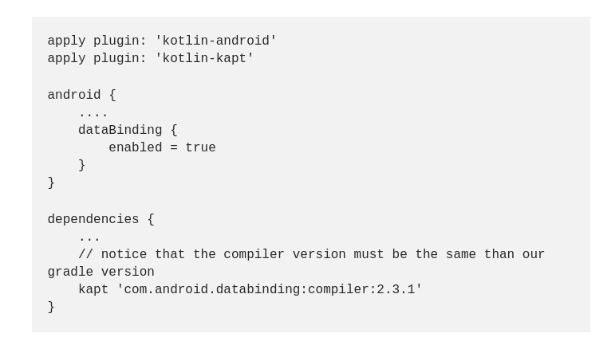
Setup

Slide 3
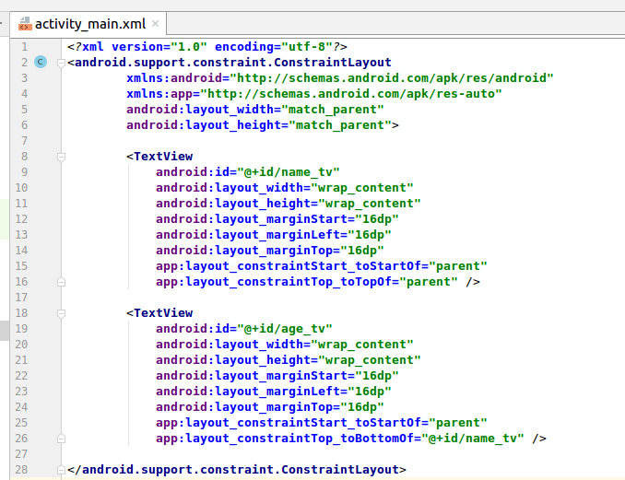
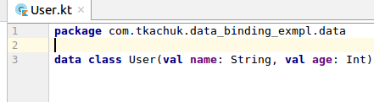
Model class and xml

Slide 4
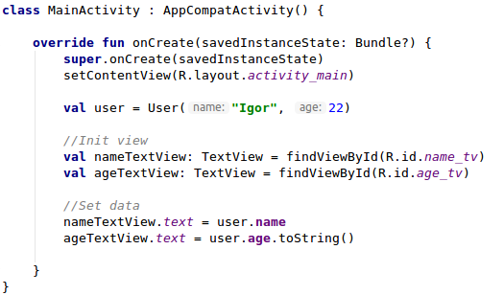
Standard way

Slide 5
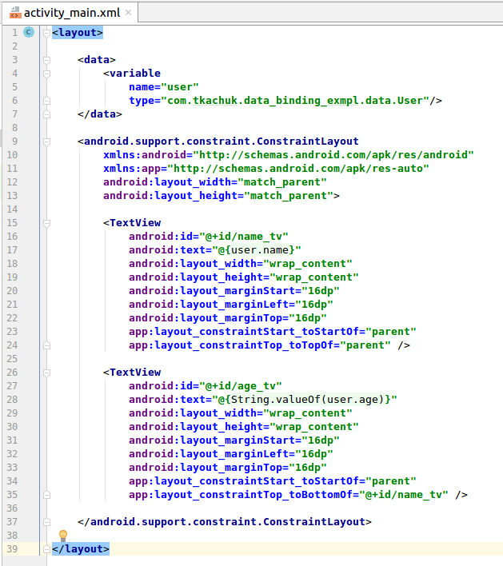
Data binding

Slide 6
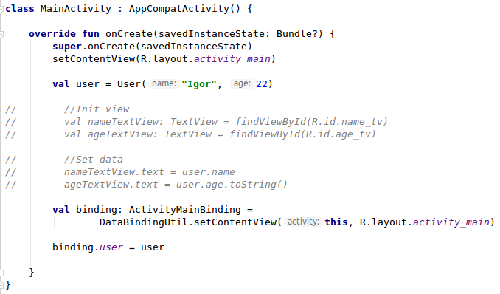
Data binding (MainActivity)

Slide 7
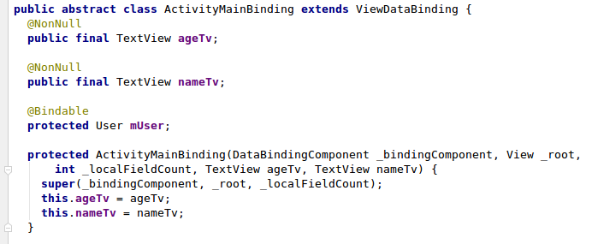
Generated class
MainActivity.kt
ActivityMainBinding.java

Slide 8


Layout expression
User.kt
activity_main.xml

Slide 9
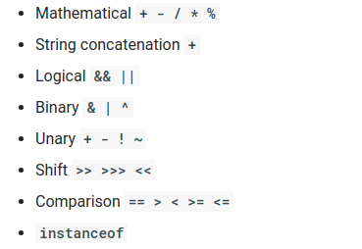
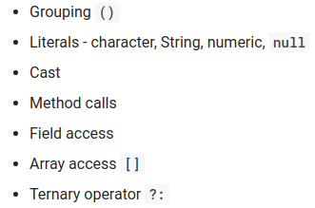
Expression language

Slide 10

Null coalescing operator
=

Slide 11
Layout expression. Observable
User.kt

Slide 12
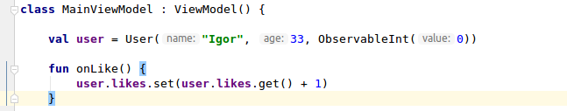


Layout expression. Observable
MainViewModel.kt
activity_main.kt

Slide 13
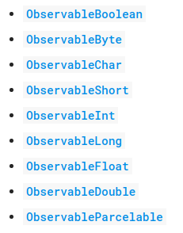
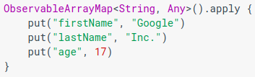
Observable fields

Slide 14
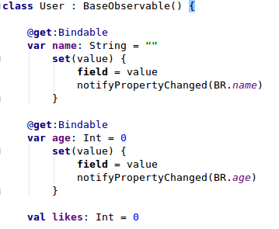
Observable objects

Slide 15

Two-way data binding

Slide 16



Binding Adapter
1
2
3

Slide 17

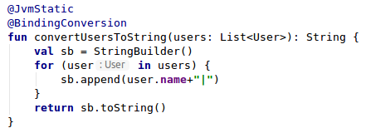
Conversion

Slide 18
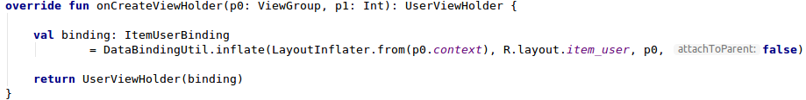

Data Binding. RecyclerView
UserListAdapter
UserViewHolder

Slide 19
Questions?
Links: http://www.fandroid.info/lektsiya-8-po-arhitekture-android-data-binding-mvvm/ https://codelabs.developers.google.com/codelabs/android-databinding/index.html?index=..%2F..index#5 https://startandroid.ru/ru/courses/architecture-components/27-course/architecture-components/552-urok-19-android-data-binding-vozmozhnosti.html https://medium.com/@jencisov/androids-data-binding-with-kotlin-df94a24ffc0f

